Slide 1
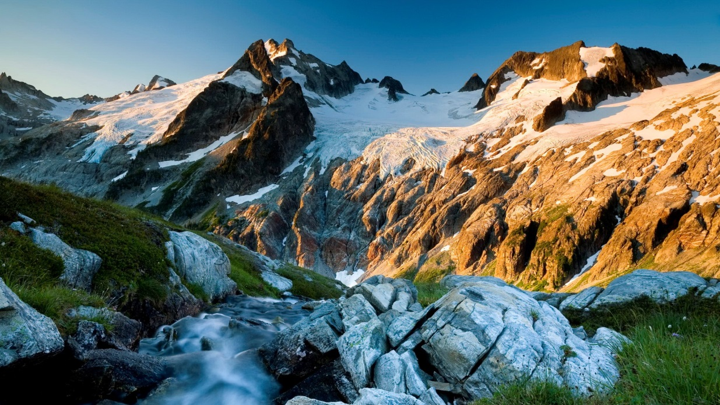
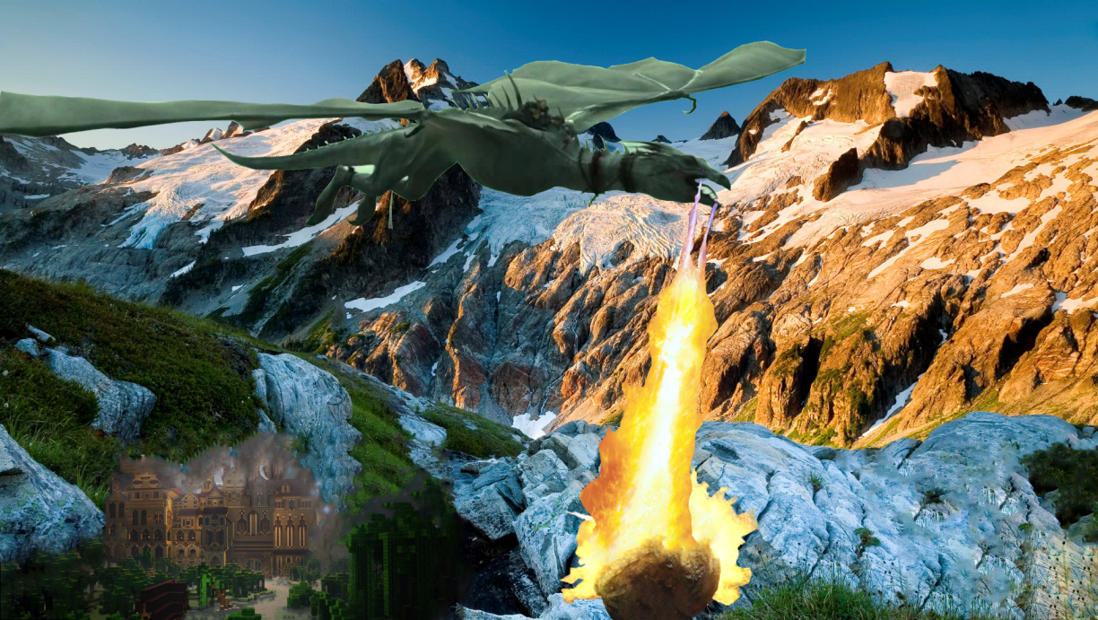
Before
I have removed background on images but kept the foreground then pasted them in a new layer in this mountain background.
After

Slide 2
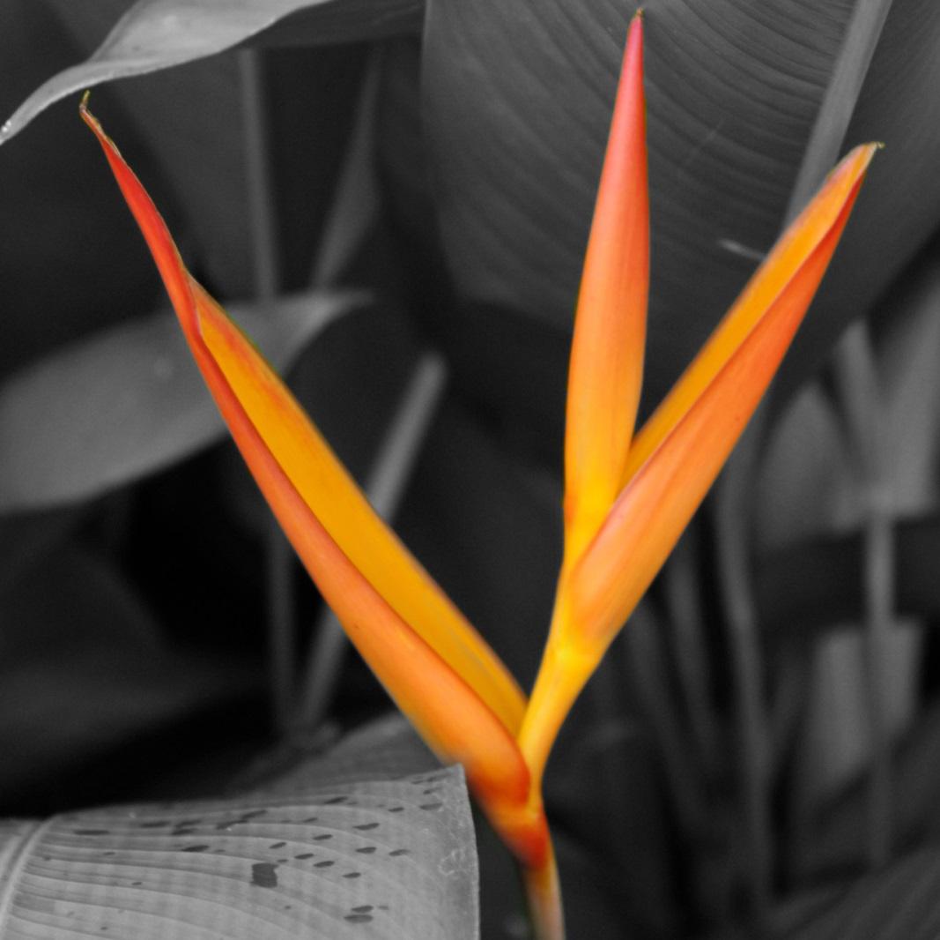
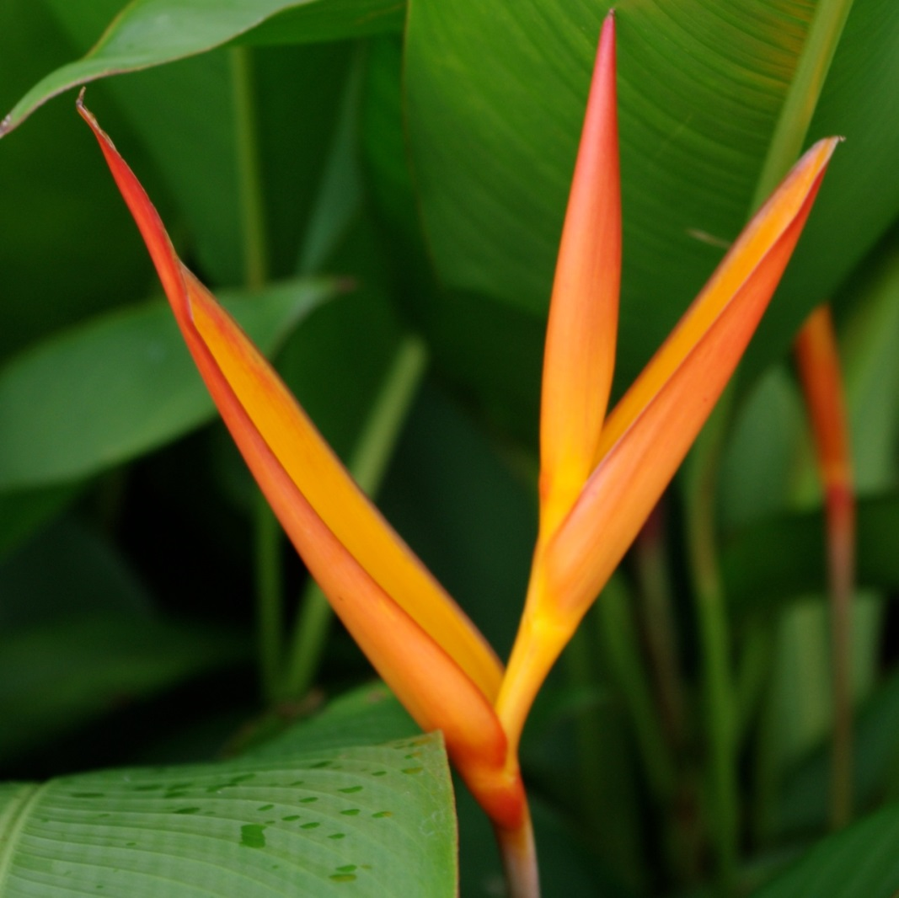
For this photo I have used the channel mixer to make the photo black and white, then used the Brush tool to paint the flowers colour on.
After
Before

Slide 3
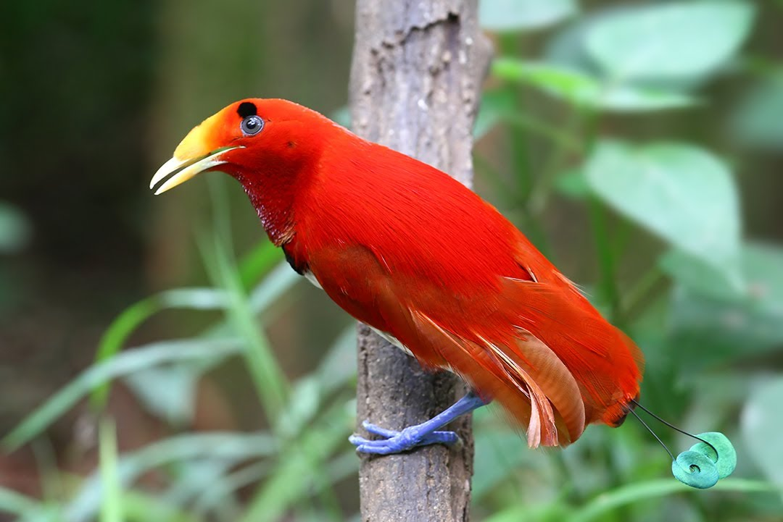
Before

